Slide 1
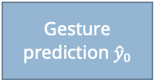
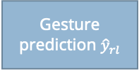



$$D_{0}=[0,…,0]$$
Deconv
BVP prediction
CSI Signal
FCN Classifier
Φ
Gesture prediction ${\hat{y}}_{0}$
Signal Processing
Signal-to-image
Feature
Encoder
Reward function $R\left(M\left({\hat{y}}_{rl},y\right)−M\left({\hat{y}}_{0},y\right)\right)$
Deconv
BVP prediction
FCN Classifier
Φ
Gesture prediction ${\hat{y}}_{rl}$
Domain Embedding
$$D_{r}=\left[d_{0},…,d_{R}\right]$$
RL Agent produces the Domain Embedding as its action
Signal latent representation used as state observation
RL Agent

